Slide 1
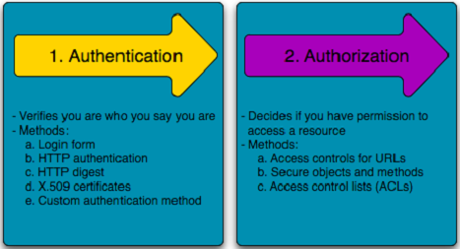
Lesson 5. Access Control

Slide 2
Outline
Introduction
Access control types
Access control Terminology
Access control models
Access control matrix
Access control monitoring
Lab
summary

Slide 3
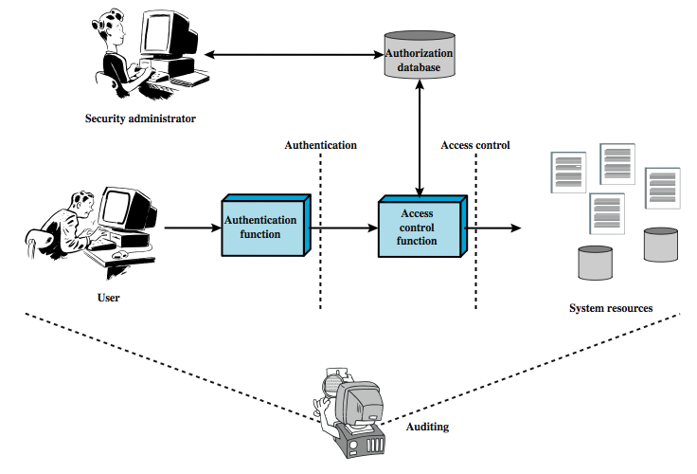
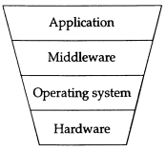
Relationship among Access Control and Other security functions
Access controls at different levels in a system

Slide 4
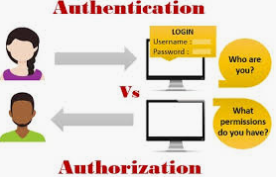


Introduction
Access control is the collection of mechanisms that permits managers of a system to exercise a directing or restraining influence over the behavior, use, and content of a system.
It permits management to specify what users can do, which resources they can access, and what operations they can perform on a system.
The goal of access control is to minimize the security risks of unauthorized access to physical and logical systems
It consists of two main components: authentication and authorization

Slide 5

Access control types
Physical access control: limits access to campuses, building, rooms, and physical IT assets. (Fencing, hardware door locks,… that limit contact with devices)
Technical access control: technology restrictions that limit users on computers from accessing data
Access controls encompass:
File permissions, such as the right to create, read, edit or delete a file.
Program permissions, such as the right to execute a program.
Data permissions, such as the right to retrieve or update information in a database.

Slide 6
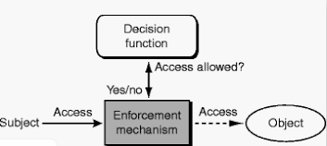
Components
The security features that control how users and systems communicate and interact with one another.
Access: The flow of information between subject and object
Subject: An active entity that requests access to an object or the data in an object
Object: A passive entity that contains information

Slide 7
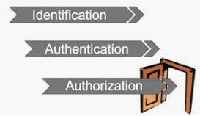
Access Control Terminology
Identification, authorization, and authorization are distinct functions.
Identification
Method of establishing the subject’s (user, program, process) identity.
Authentication
Method of proving the identity
Authorization
Determines that the proven identity has some set of characteristics associated with it that gives it the right to access the requested resources.

Slide 8

Identification
Method of establishing the subject’s (user, program, process) identity.
Use of user name or other public information
Know identification component requirements.
When using identification values to users, the following should be in place:
Each value should be unique, for user accountability;
A standard naming scheme should be followed;
The value should be non-descriptive of the user’s position or tasks

Slide 9

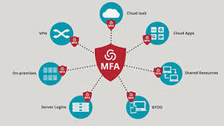
Authentication
Method of proving the identity
Something a person is, has, or does.
Use of biometrics, passwords, passphrase, token, or other private information.
Strong authentication is important
To be properly authenticated, the subject is usually required to provide a second piece to the credential set (i.e., password, passphrase, key, PIN, token etc(.

Slide 10
Authorization
Determines that the proven identity has some set of characteristics associated with it that gives it the right to access the requested resources.
Grating access rights to subjects should be based on the level of trust a company has in a subject and the subject’s need to know.
Is a core component of every operating system and established whether a user is authorized to access a particular resource and what actions he is permitted to perform on the resource.

Slide 11
Authorization
Access criteria can be thought of as:
Roles:
Is an effective way to assign rights to a type of user who performs a certain task (job assignment or function).
Groups:
When several users require same type of access to information and resources
Location:
To restrict unauthorized individuals from being able to get in and reconfigure the server remotely
Time:
Restrict the times that certaun actions or services can be accessed
Transaction type:
Can be used to control what data is assesses during certain types of functions and what commends can be carried out on the data

Slide 12
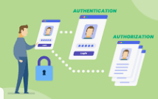
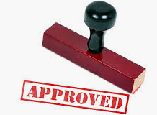
Authorization
Problems in controlling access to assess:
Different levels of users with different levels of access
Resources may be classified differently
Diverse identity of data
Corporate environments keep changing
Solutions that enterprise wide and single sign on solutions
User provisioning
Password synchronization and reset
Centralized auditing and reporting
Integrated workflow (increase in productivity)
Regulatory compliance

Slide 13
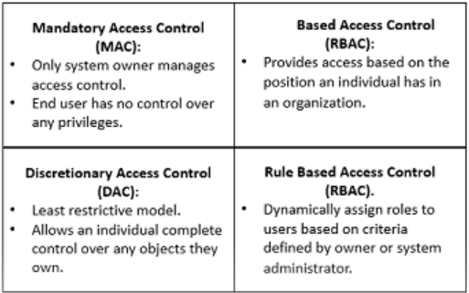



Access Control models
How does someone grant the right level of permission to an individual so that they can perform their duties? Access control models define how permissions are assigned.
Access control model – hardware and software predefined framework that custodian can use for controlling access
Access control models have four flavors:
Mandatory access control (MAC)
Discretionary access control (DAC)
Role-Based access control
Rule-Based access control
Attribute-based access control

Slide 14




Mandatory Access Control (MAC)
This is a security model in which access rights are regulated by a central authority based on multiple levels of security.
This means the end user has no control over any settings that provide any privileges to anyone.

Slide 15
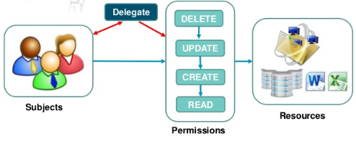

Discretionary Access Control (DAC)
DAC allows an individual complete control over any objects they own along with the programs associated with those objects.

Slide 16
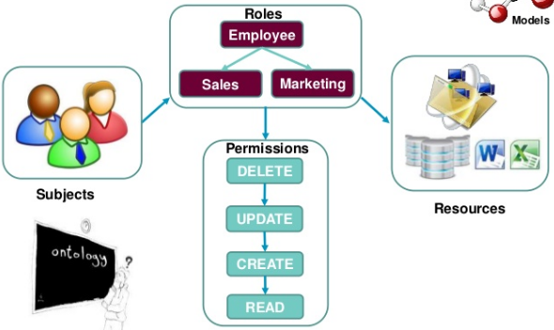
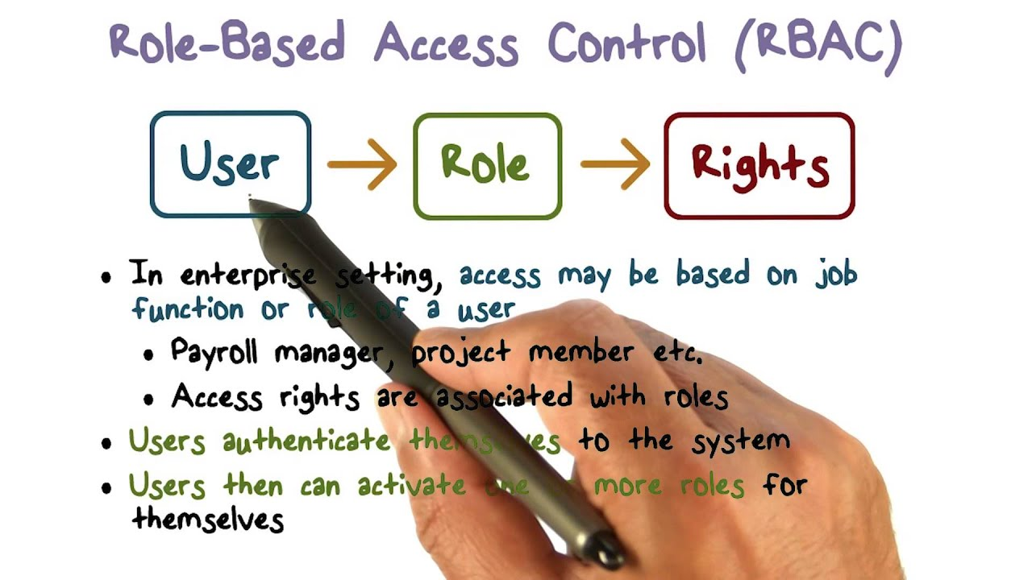

Role-Based Access Control (RBAC)
Provides access control based on the position an individual fills in an organization.
Restricts access to computer resources based on individuals or groups with defined business functions.

Slide 17



Rule-Based Access Control
This is a security model in which the system administrator defines the rules that govern access to resource objects.
These rules are based on conditions, such as time of day or location.
For example: if someone is only allowed access to files during certain hours of the day, Rule-Based Access Control would be the tool of choice.

Slide 18
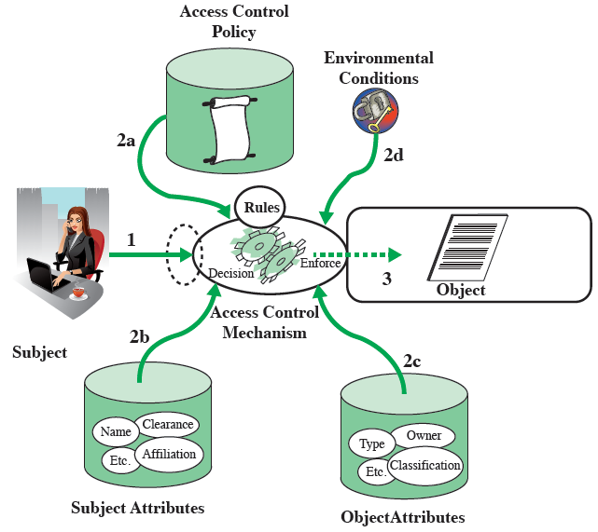
Attribute-based Access Control (ABAC)
Define authorizations that express conditions on properties of both the resource and the subject
Types of attributes
Subject attributes: Name, Organization, Job title
Object attributes: Title, Author, Date
Environment attributes: Describe the operational, technical, and even situational environment or context in which the information access occurs: Current date, Network security level, Current virus/hacker activities

Slide 19
Implementing Access Control
Access control is a process that is integrated into an organization’s IT environment. It can involve identity management and access management systems.
These systems provide access control software, a user database, and management tools for access control policies, auditing and enforcement.
When a user is added to an access management system, system administrators use an automated provisioning system to set up permissions based on access control frameworks, job responsibilities and workflows.
Access control requirement: least privilege

Slide 20
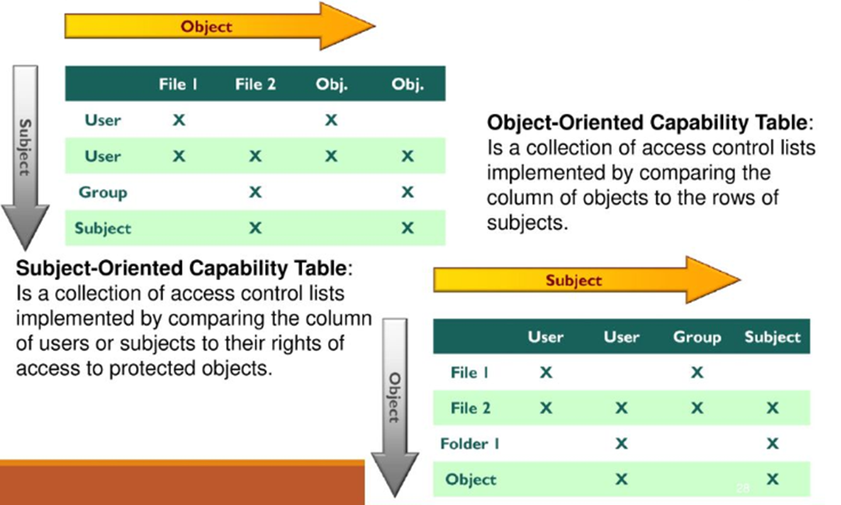
Access Control Matrix
Is a table of subjects and objects indicating what actions individual subjects can take upon individual objects
Two types:
Capability table (bound to a subject)
Access control List (bound to an object)

Slide 21
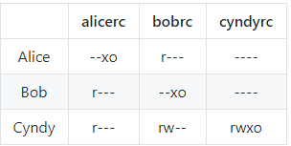
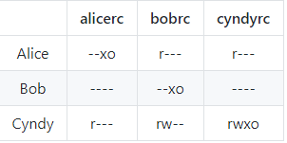
Ex1: Consider a computer system with three users: Alice, Bob, and Cyndy. Alice owns the file alicerc, and Bob and Cyndy can read it. Cyndy can read and write the file bobrc, which Bob owns, but Alice can only read it. Only Cyndy can read and write the file cyndyrc, which she owns. Assume that the owner of each of these files can execute it.
a. Create the corresponding access control matrix.
b. Cyndy gives Alice permission to read cyndyrc, and Alice removes Bob’s ability to read alicerc. Show the new access control matrix.

Slide 22
Ex2: Alice can read and write to the file x, can read the file y, and can execute the file z. Bob can read x, can read and write to y, and cannot access z
Write a set of access control lists for this situation. Which list is associated with which file?
Write a set of capability lists for this situation. With what is each list associated?
Set of access control lists. They are object focused so each list is associated with a file.
ACL(FileX) = Alice: {read, write}, Bob: {read}
ACL(FileY) = Alice: {read}, Bob: {read, write}
ACL(FileZ) = Alice: {execute}, Bob: {}
Set of capability lists. They are subject focused, so each list is associated with a user.
CList(Alice) = FileX: {read, write}, FileY: {read}, FileZ: {execute}
CList(Bob) = FileX: {read}, FileY: {read, write}, FileZ: {}

Slide 23
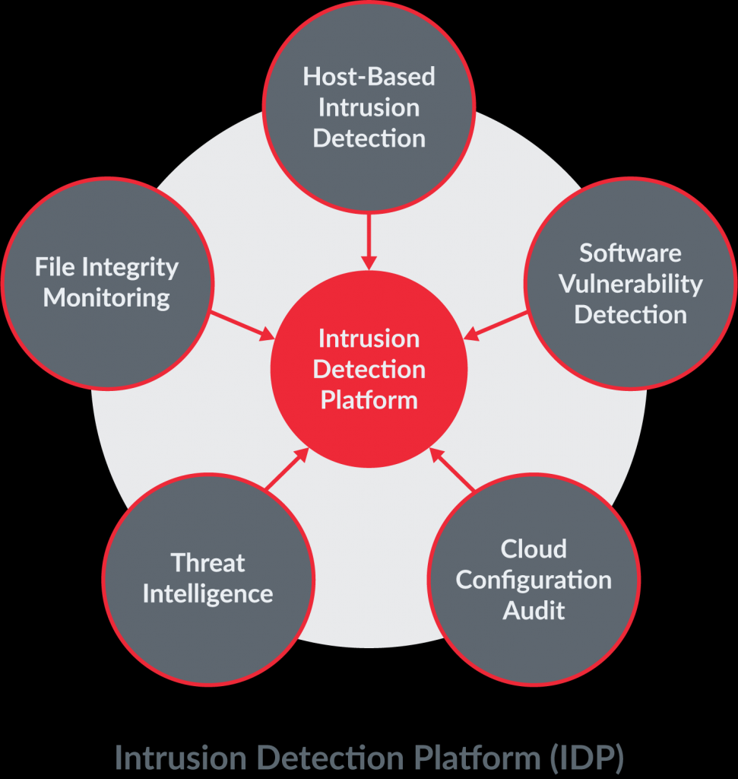





Access Control Monitoring
Intrusion detection
Three common components
Sensors
Analyzers
Administrator Interfaces
Common types
Intrusion detection
Intrusion prevention
Honeypots
Network sniffers

Slide 24
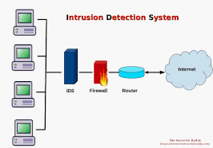





Access Control Monitoring
Two main types of Intrusion Detection Systems
Network Based (NIDS)
Host Based (HIDS)
HIDS & NIDS can be
Signature Based
Statistical Anomaly Based
Protocol anomaly based
Traffic anomaly based
Rule Based

Slide 25
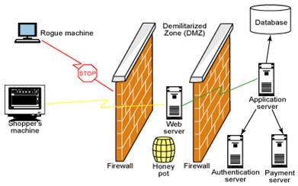
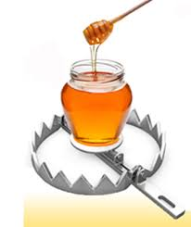

Access Control Monitoring
Intrusion Prevention System
Is a preventive and proactive technology, IDS is a detectve technology
Two types: Network Based (NIPS) and Host Based (HIPS)
Honeypots
An attractive offering that hopes to lure attackers away from critical systems
Network sniffers
A general term for programs or devices that are able to examine traffic on a LAN segment.

Slide 26
Lab
Linux: chmod
Windows: NTFS permission

Slide 27
Summary
Access control is a fundamental component of data security.
Access control policy
Access control models
Access control matrix

